Slide 1

RUNGTA COLLEGE OF DENTAL SCIENCES & RESEARCH
TITLE OF THE TOPIC
DEVELOPMENTAL DISTURBANCES OF TEETH
DEPARTMENT OF ORAL PATHOLOGY & MICROBIOLOGY

Slide 2
Specific learning Objectives
Core areas* | Domain ** | Category #
DEVELOPMENTAL DISTURBANCES | COGNITIVE | MUST KNOW
AMELOGENESIS IMPERFECTA DENTINOGENESIS IMPERFECTA DENTIN DYSPLASIA REGIONAL ODONTODYSPLASIA SHELL TOOTH | COGNITIVE COGNITIVE COGNITIVE COGNITIVE COGNITIVE COGNITIVE | MUST KNOW MUST KNOW MUST KNOW MUST KNOW MUST KNOW
AMELOGENESIS IMPERFECTA DENTINOGENESIS IMPERFECTA DENTIN DYSPLASIA REGIONAL ODONTODYSPLASIA SHELL TOOTH | COGNITIVE COGNITIVE COGNITIVE COGNITIVE COGNITIVE COGNITIVE | MUST KNOW MUST KNOW MUST KNOW MUST KNOW MUST KNOW

Slide 3
Table of Content
DEVELOPMENTAL DISTURBANCES
AMELOGENESIS IMPERFECTA
DENTINOGENESIS IMPERFECTA
DENTIN DYSPLASIA
REGIONAL ODONTODYSPLASIA
SHELL TOOTH

Slide 4
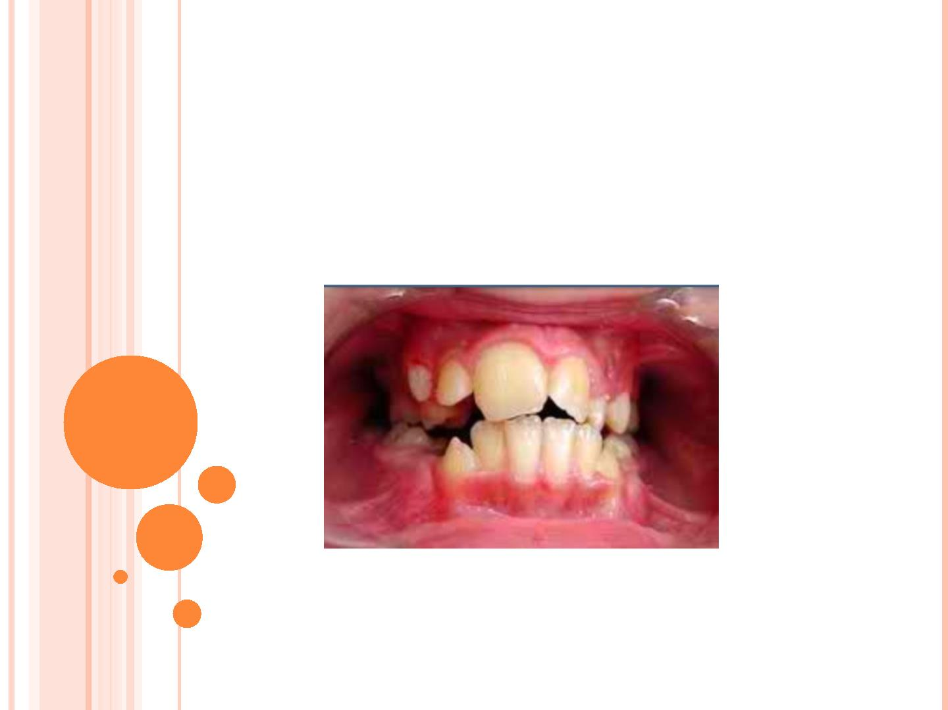
DISTURBANCES
OF THE TEETH

Slide 5
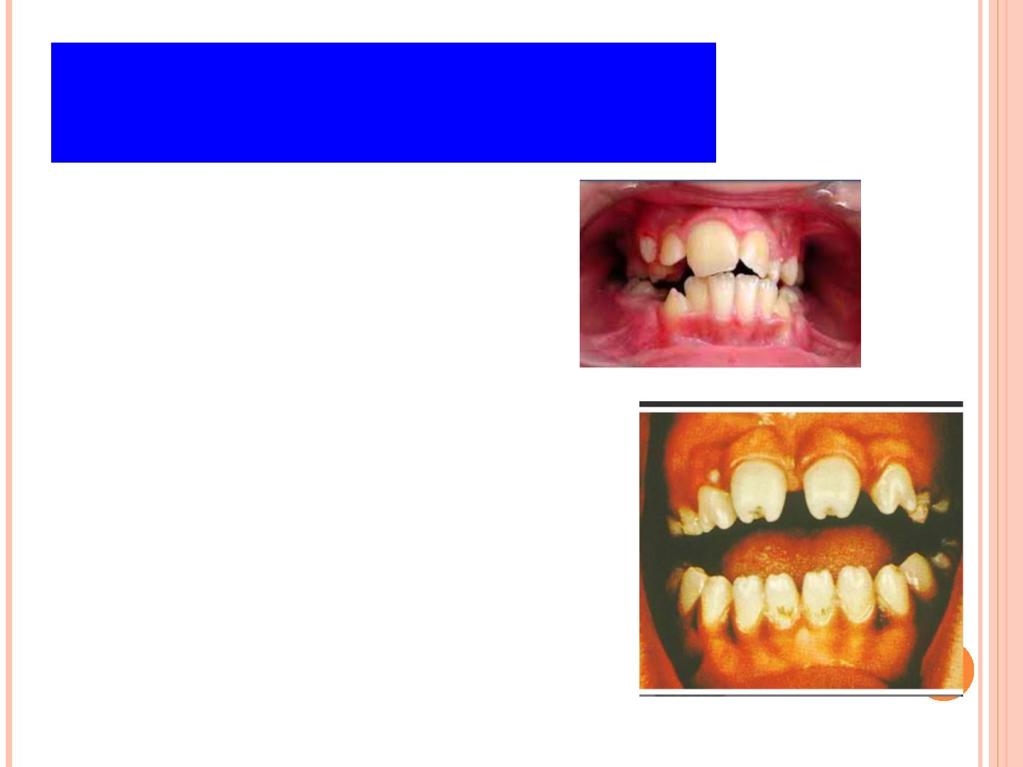
Developmental
Disturbances
➢
(1) Size
➢
➢
➢
(2) Number and Eruption
(3) Shape/Form
(4) Defects of Enamel and Dentin

Slide 6
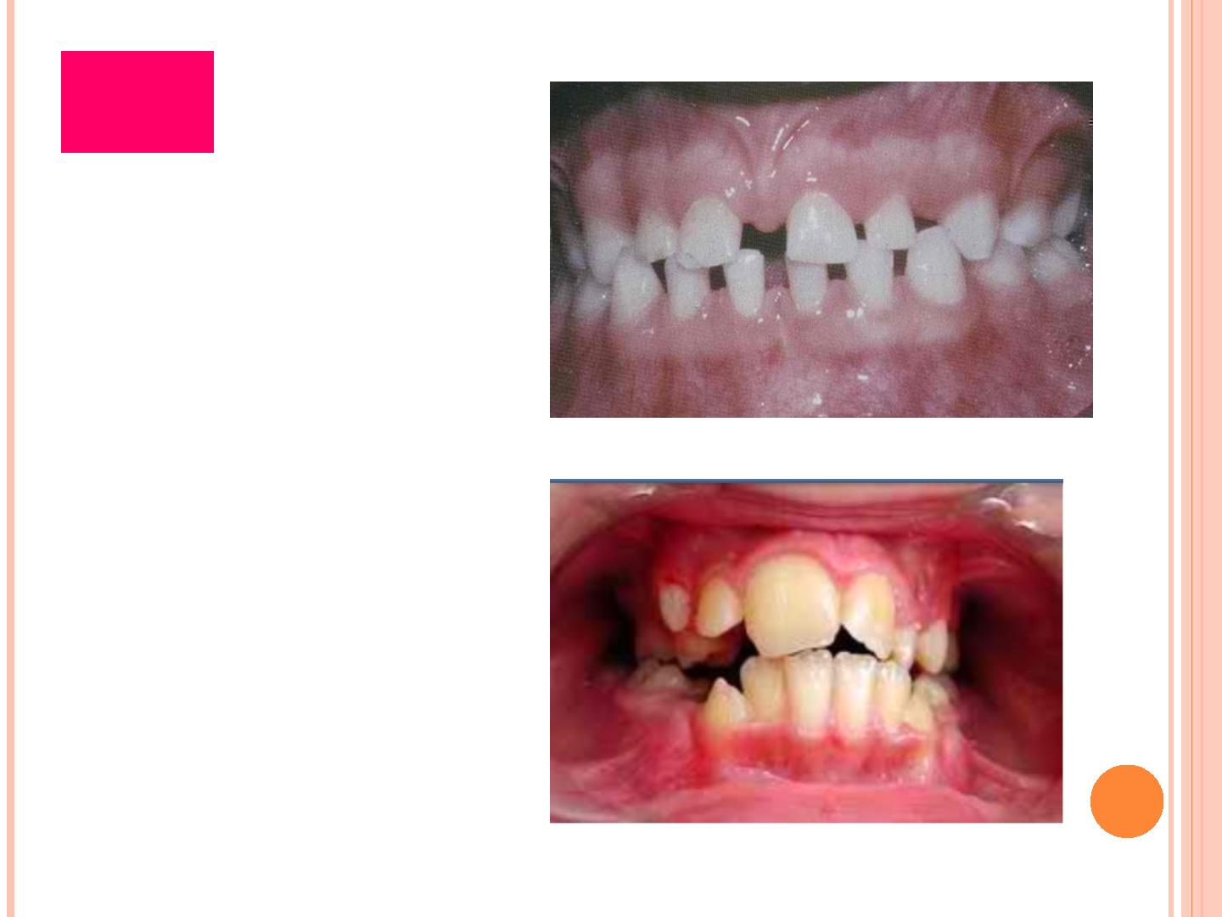
Size
➢
Microdontia
Macrodontia
➢

Slide 7

Size
➢
Microdontia
✓
✓
✓
(1) True Generalized
Microdontia
(2) Relative Generalized
Microdontia
(3) Focal or Localized
Microdontia

Slide 8
Size
➢
Macrodontia
✓
✓
✓
(1) True Generalized
Macrodontia
(2) Relative Generalized
Macrodontia
(3) Focal or Localized
Macrodontia

Slide 9
Developmental
Disturbances
➢
(1) Size
➢
➢
➢
(2) Number and Eruption
(3) Shape/Form
(4) Defects of Enamel and Dentin

Slide 10
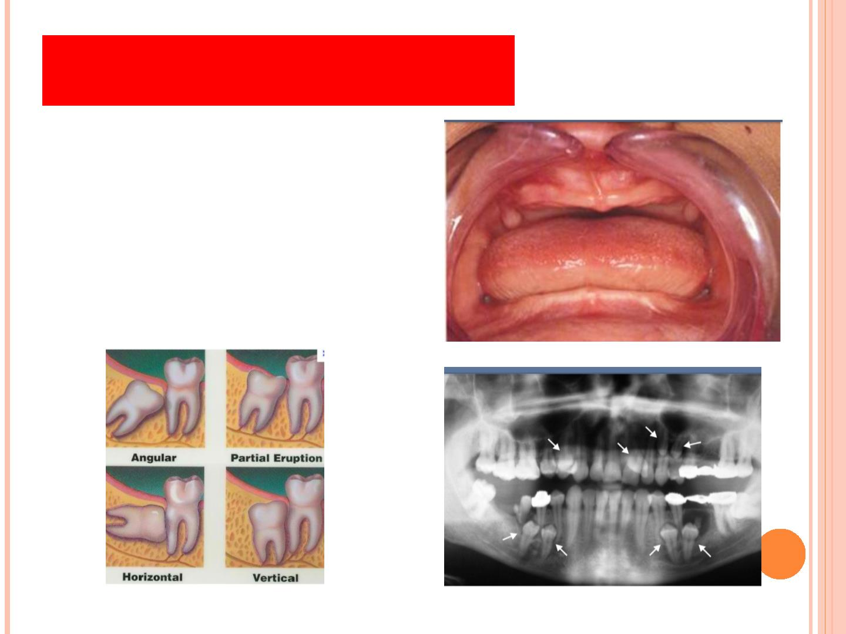
Number and Eruption
➢
Supernumerary
Anodontia
➢
➢
Impaction

Slide 11
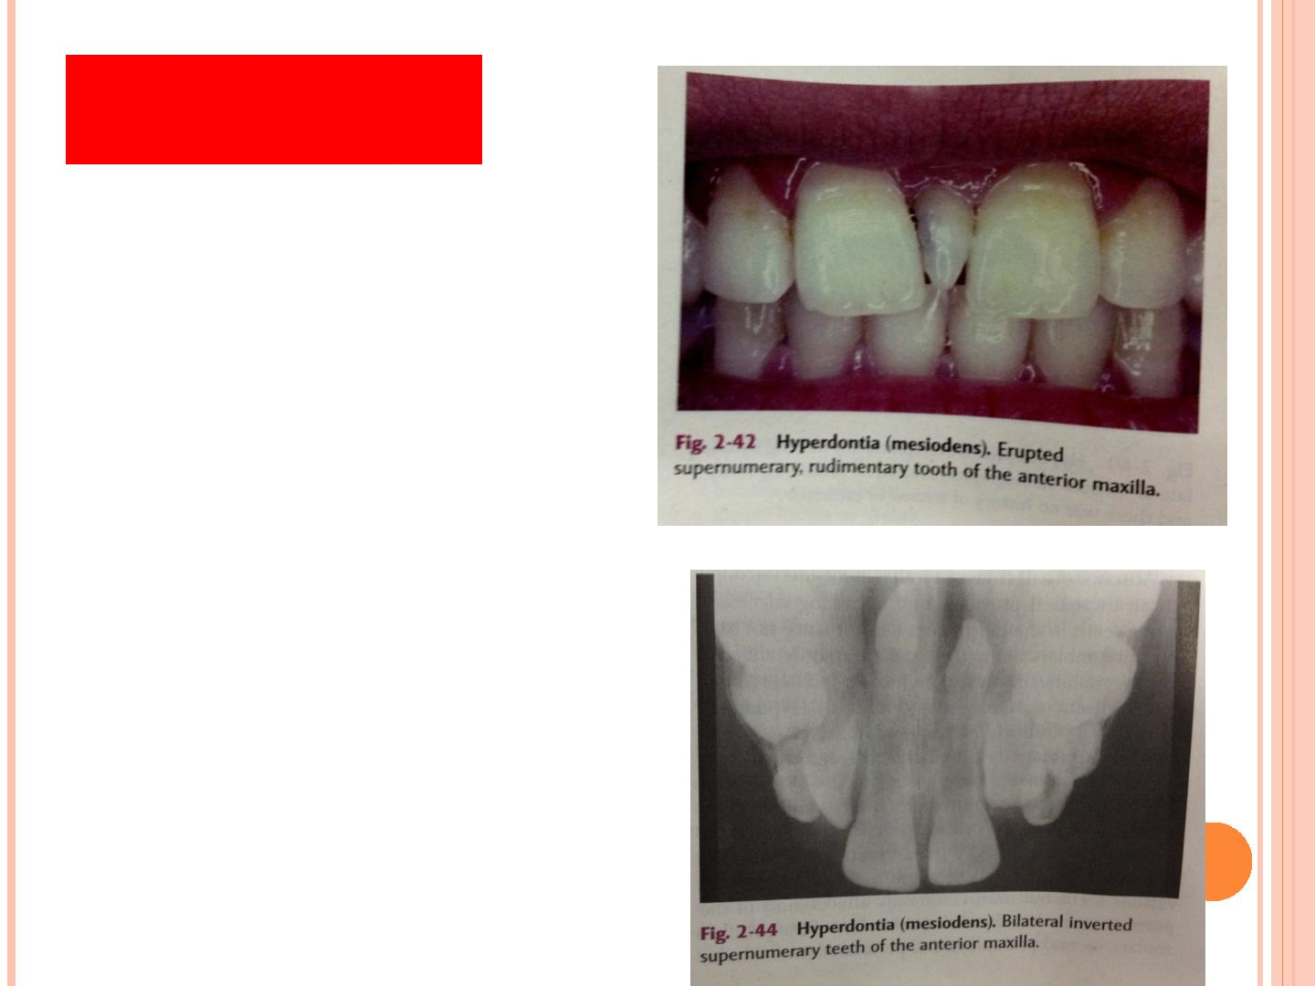
Mesiodens
➢
most common
supernumerary tooth
➢
tooth situated between
maxillary central incisors
✓
✓
✓
✓
singly
paired
erupted or impacted
inverted

Slide 12
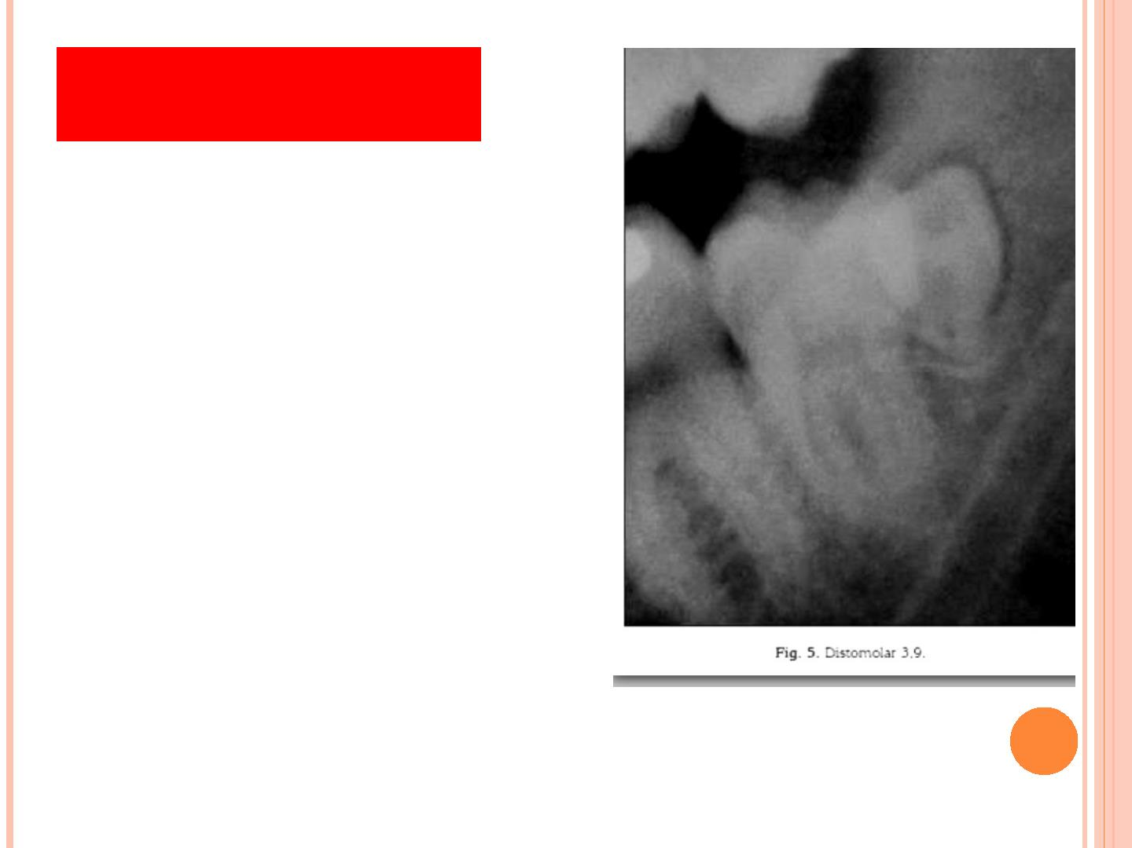
Fourth Molar
➢
➢
➢
2
^{nd} most common
situated distal to 3rd molar
small rudimentary tooth,
but may be of normal size
➢
mandibular 4th molar also is
seen occasionally, but less
common than maxillary molar

Slide 13
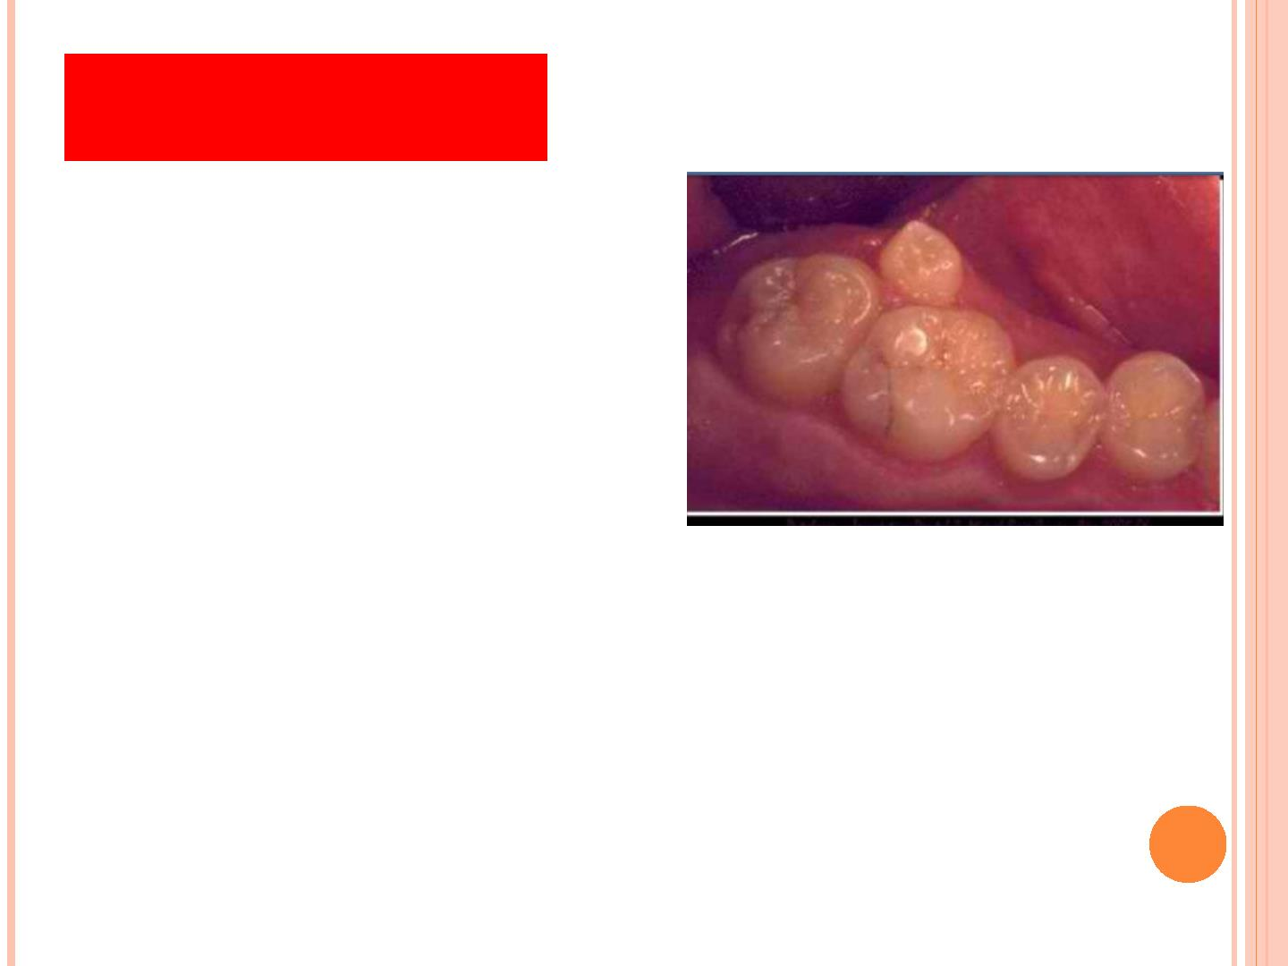
Paramolar
➢
small + rudimentary
➢
➢
situated bucally or lingually
to one of the maxillary
molars
interproximally between 1st
+ 2nd or 2nd + 3rd maxillary
molars

Slide 14
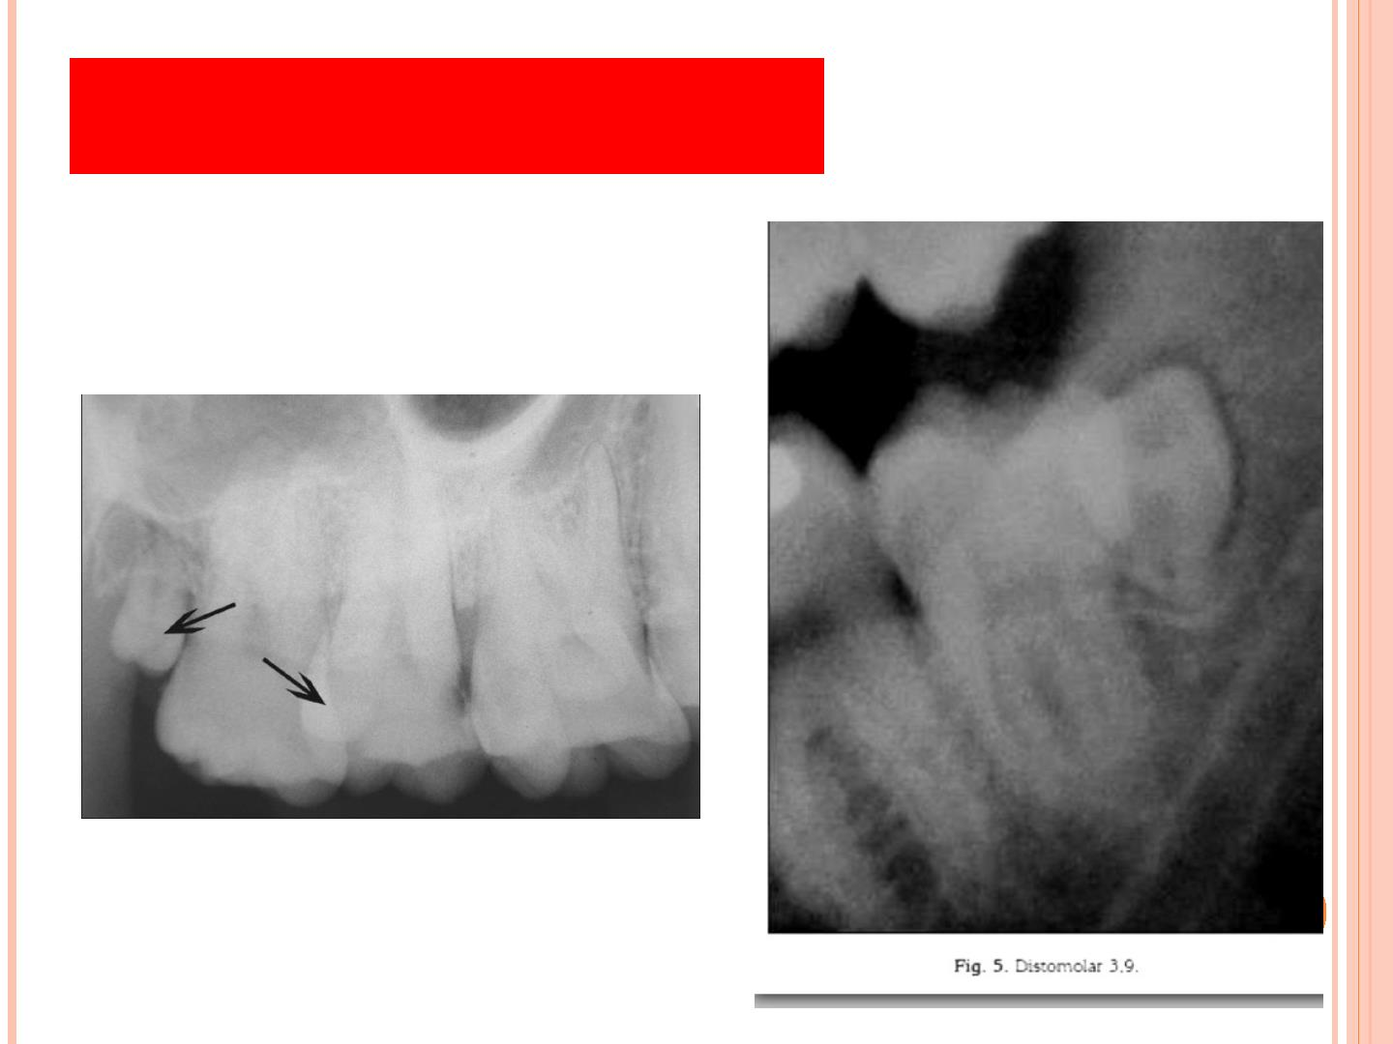
Distomolar/Distodens
➢
molar located distal to molar

Slide 15
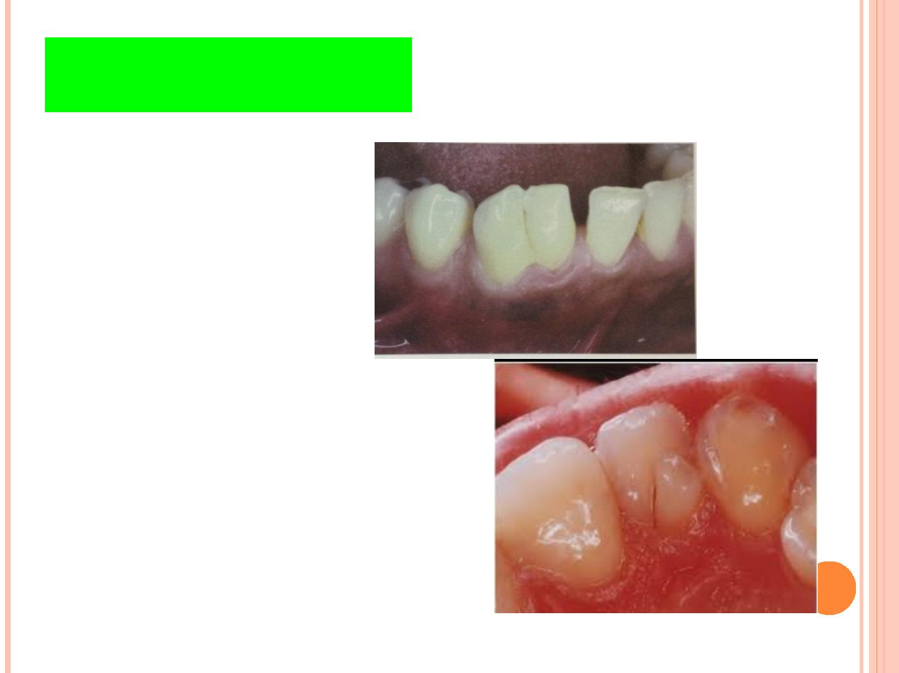
Shape and Form
➢
Crown
✓
✓
✓
✓
✓
Fusion
Gemination
Taurodontism
Talon’s Cusp
Leong’s Cusp

Slide 16
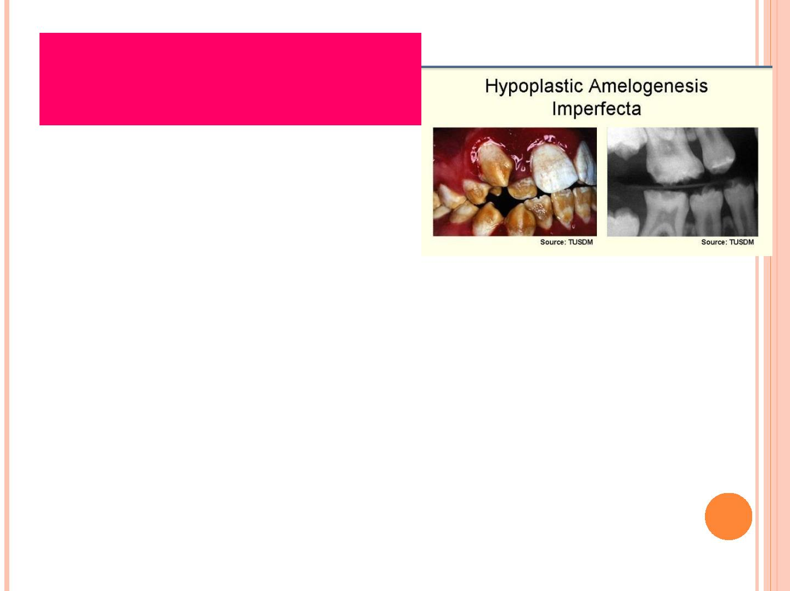
Amelogenesis
Imperfecta
➢
also known as:
✓
Hereditary Enamel
Dysplasia
✓
✓
Hereditary Brown Enamel
Hereditary Brow Opalescent
Teeth

Slide 17
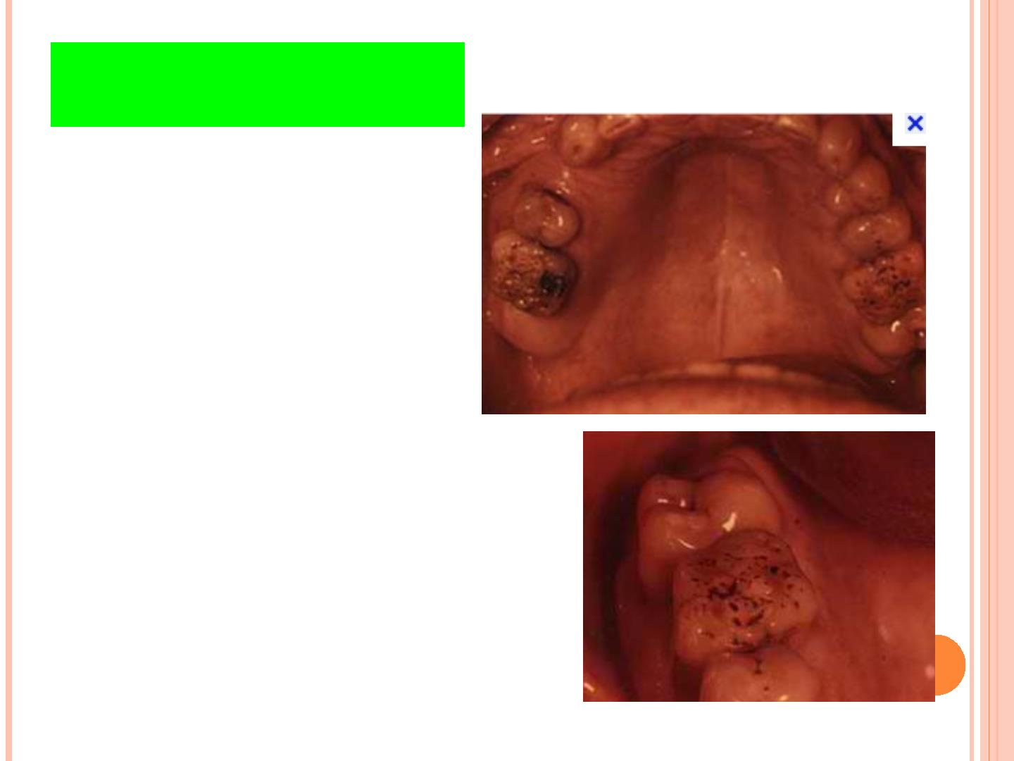
Shape and Form
➢
Crown
✓
✓
✓
✓
Dens Invaginatus
Peg-shaped Lateral
Hutchinson Incisor
Mulberry Molar

Slide 18
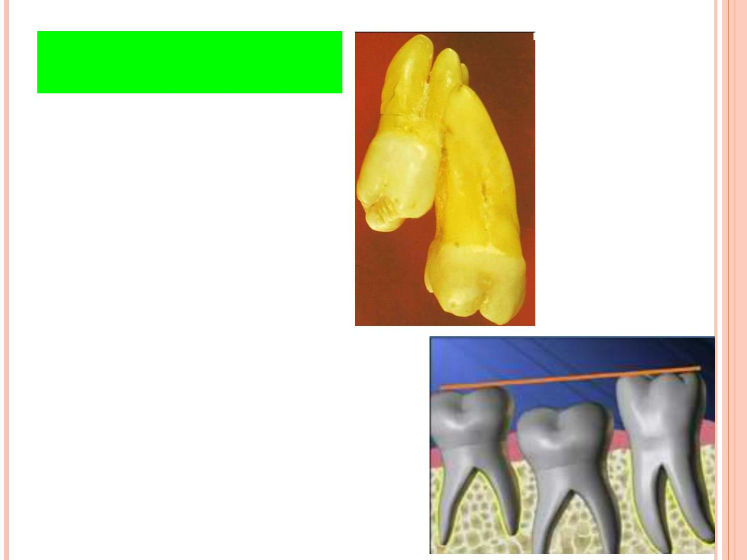
Shape and Form
➢
Root
✓
✓
✓
✓
✓
Concresence
Enamel Pearl
Dilaceration
Flexion
Ankylosis

Slide 19
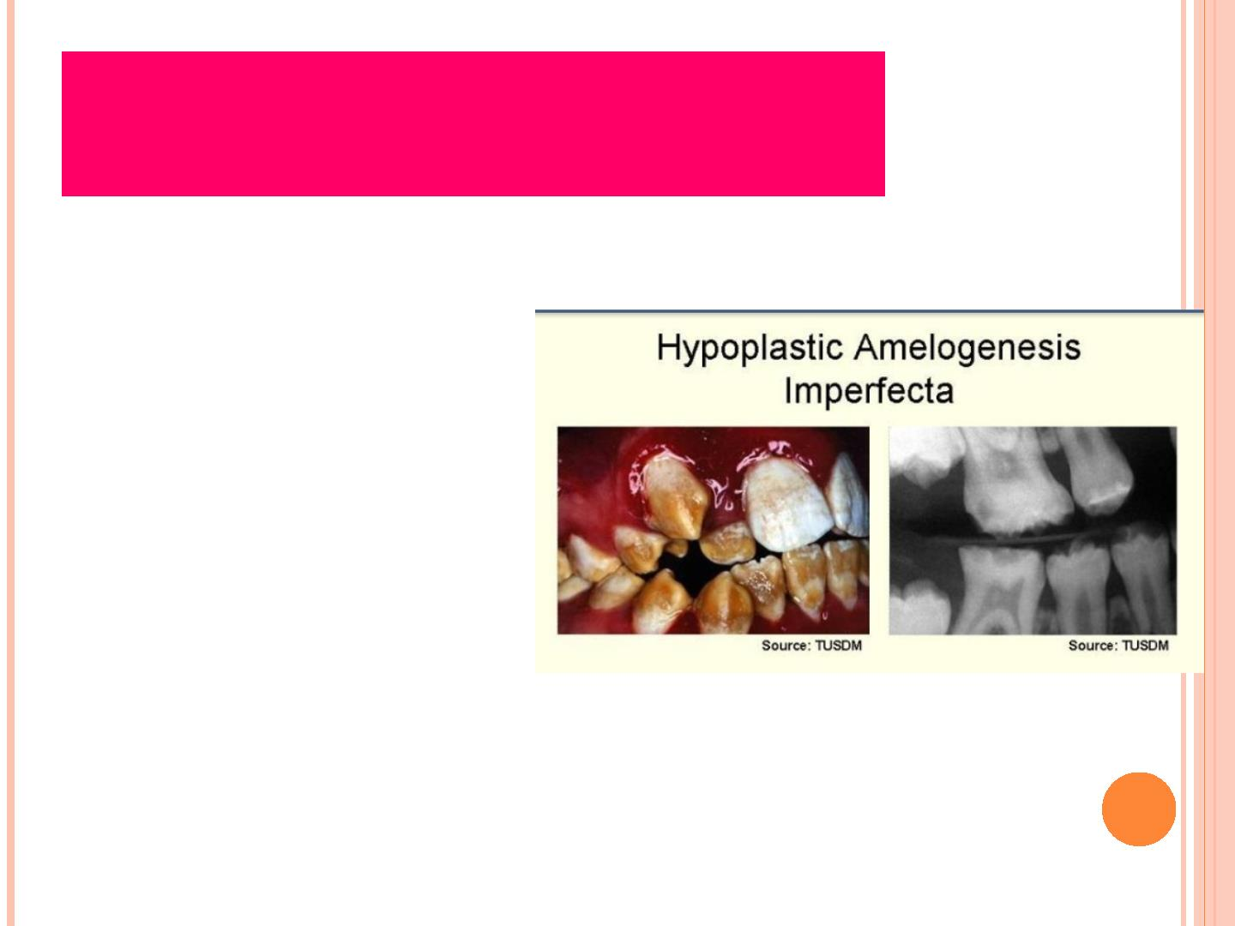
Hypoplastic
Amelogenesis Imperfecta
➢
inadequate formation of matrix
➢
enamel is randomly:
✓
✓
✓
pitted
grooved or very thi
hard + translucent
➢
defects become stained but teeth
are not especially susceptible to
caries unless enamel is scanty
and easily damaged

Slide 20
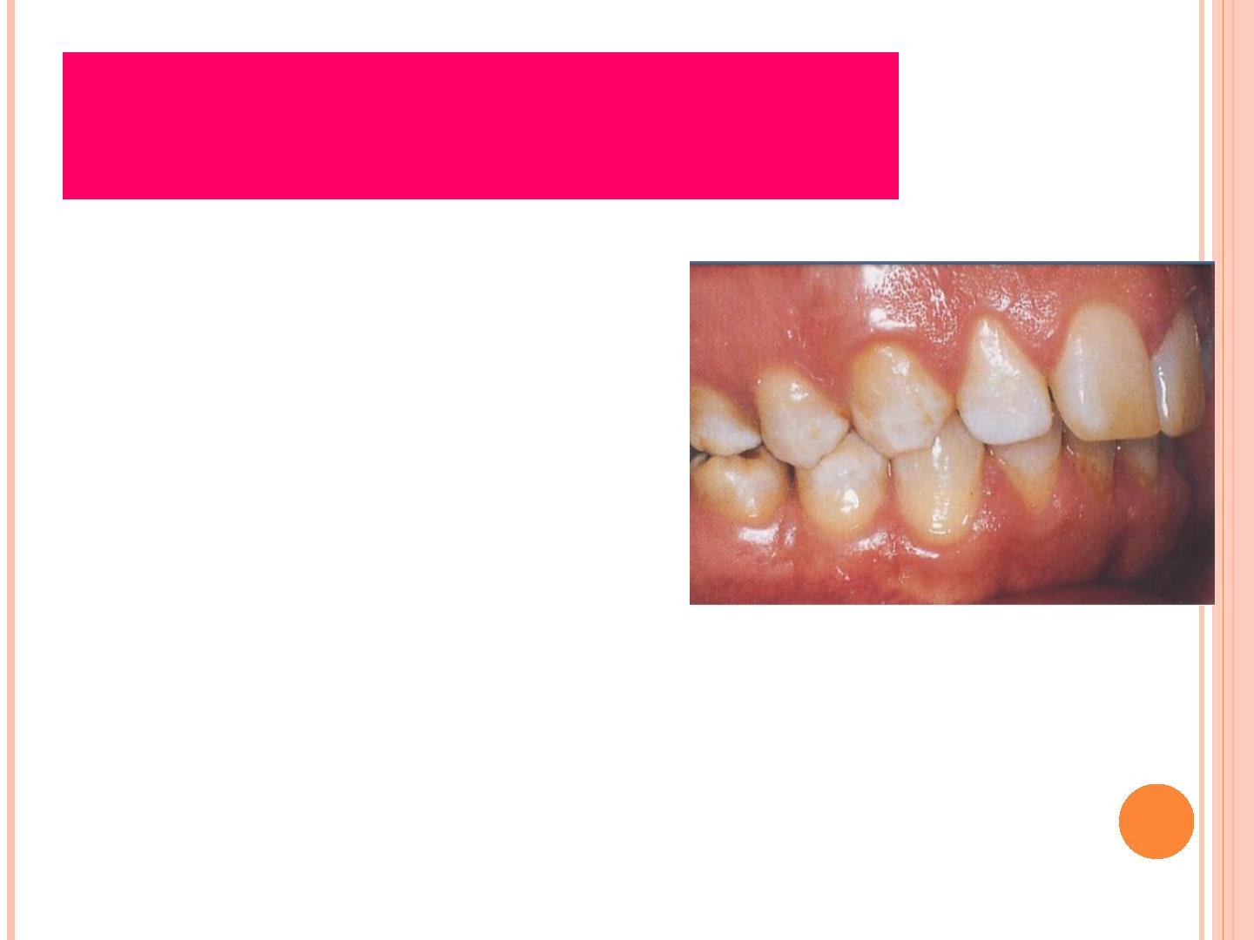
Hypomaturation
Amelogenesis Imperfecta
➢
enamel is normal in form on
eruption but:
✓
✓
✓
✓
opaque
white to brownish-yellow
softer than normal
tends to chip from
underlying
dentin

Slide 21
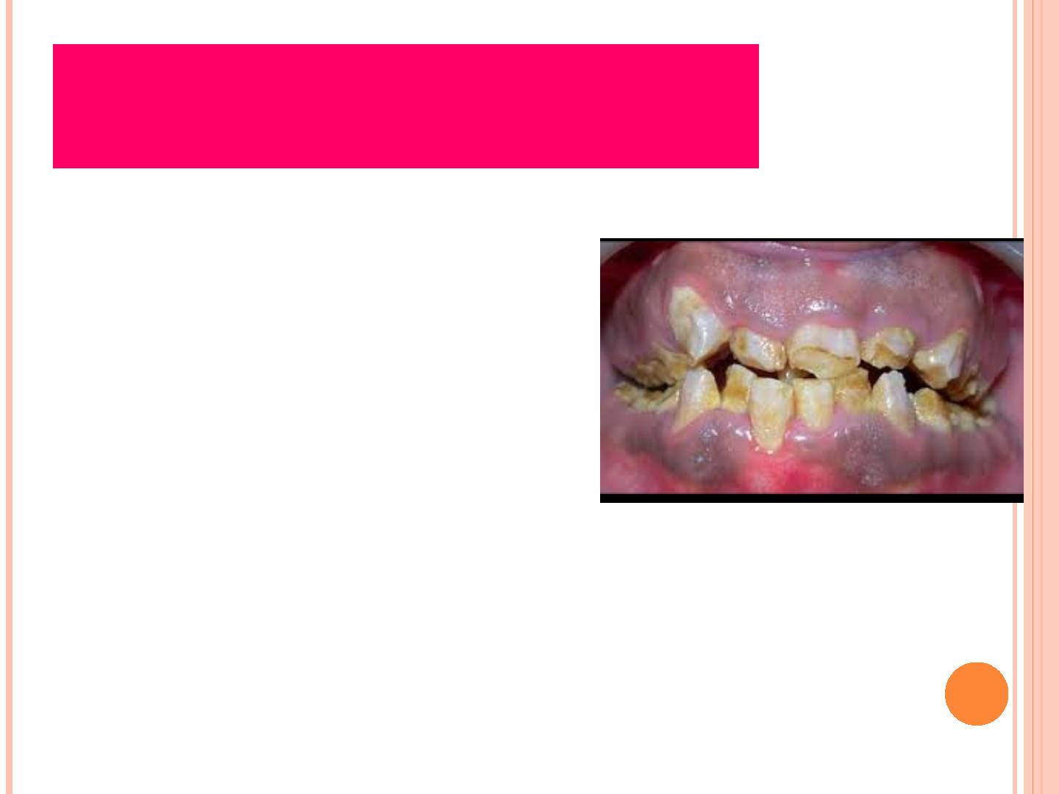
Hypocalcified
Amelogenesis Imperfecta
➢
enamel matrix is formed in
normal quantity
➢
➢
poorly calcified
when newly erupted:
✓
✓
✓
✓
enamel is normal in thickness
normal form
but weak
opaque or chalky in appearance

Slide 22
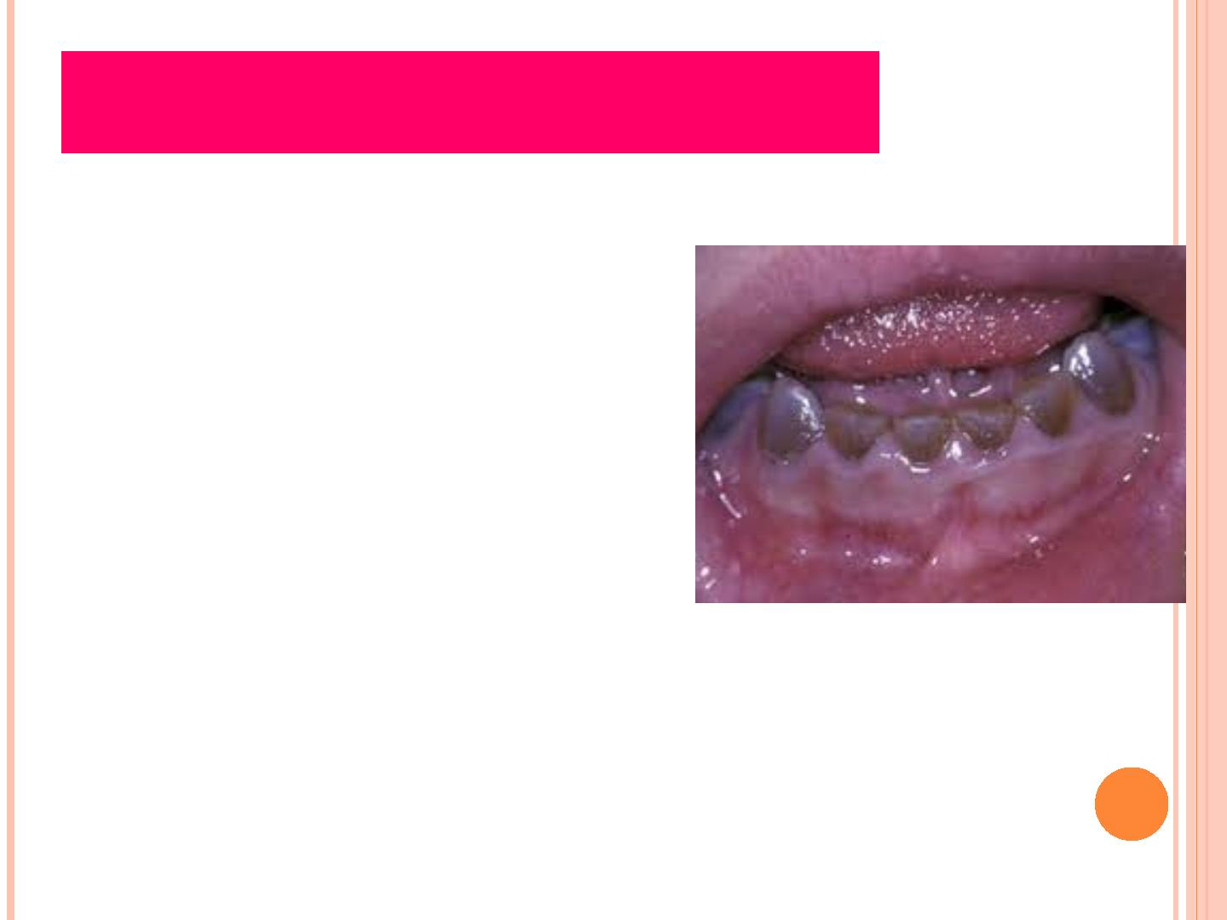
Dentinogenesis Imperfecta
➢
also known as “Hereditary
Opalascent Dentin”
✓
due to clinical discoloration
of teeth
➢
➢
mutation in the dentin
sialophosphoprotein
affects both primary + permanent
dentition

Slide 23

Type I Dentinogenesis
Imperfecta
➢
occurs in families with
Osteogenesis Imperfecta
➢
primary teeth are more severely
affected than permanent teeth

Slide 24
Type II Dentinogenesis
Imperfecta
➢
never occurs in association
with osteogenesis imperfecta
unless by chance
➢
➢
most frequently referred to as
hereditary opalascent dentin
only have dentin abnormalities
and no bone disease

Slide 25

Type III Dentinogenesis
Imperfecta
➢
“Bradwine type”
➢
➢
racial isolate in Maryland
multiple pulp exposures in
deciduous not seen in type
I or II
➢
periapical radiolucencies

Slide 26
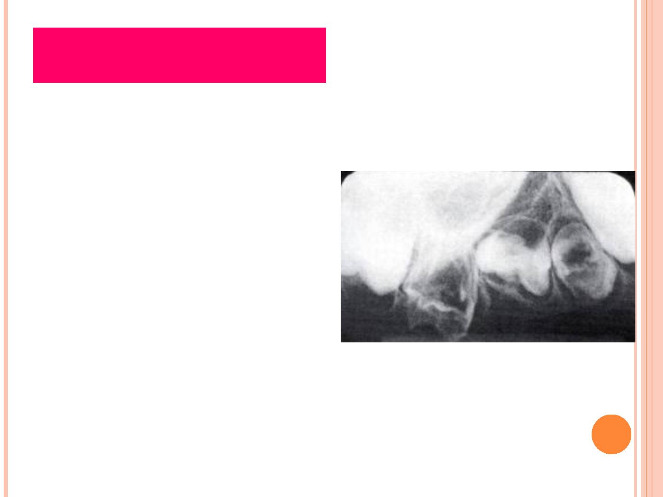
Dentin Dysplasia
➢
also known as “Rootless Teeth”
➢
rare disturbance of dentin
formation
➢
➢
➢
➢
normal enamel
atypical dentin formation
abnormal pulpal morphology
hereditary disease

Slide 27

Dentin Dysplasia
➢
Classification:
✓
✓
Type I (Radicular Type)
Type II (Coronal Type)

Slide 28

Regional
Odontodysplasia
➢
also known as:
✓
✓
✓
Odontogenic Dysplasia
Odontogenesis Imperfecta
Ghost Teeth

Slide 29

Shell Tooth
➢
normal thickness enamel
extremely thin dentin
enlarged pulps
➢
➢
➢
thin dentin may involve
entire tooth or be isolated
to the root
➢
most frequently in deciduous

Slide 30
Take home message
Developmental disturbances can be due to
Number of teeth
Size of teeth
Eruption of teeth
Altered morphology of teeth

Slide 31
Question & Answer Session
ENUMERATE DEVELOPMENTAL DISTURBANCE OF ORAL CAVITY.
DESCRIBE AMELOGENESIS IMPERFECTA.
CLASSIFICATION OF DENTIN DYSPLASIA.
WRITE ABOUT MESIODENS
DENTINOGENESIS IMPERFECTA

Slide 32
REFERENCES
NAME OF THE BOOK WITH EDITION AND PAGE NUMBERS
ARTICLE ARE TO BE MENTIONED IF NEEDED
SHAFER’S 9th EDITION
LUCAS
NEVILLE
REGEZI

Slide 33
THANK YOU

